Slide 1
CS 590 Algorithm
Chapter 9 Fast Sorting and Selection
Source: Goodrich, M. T., & Tamassia, R. (2015). Algorithm Design and Applications. Hoboken, NJ: Wiley.

Slide 2
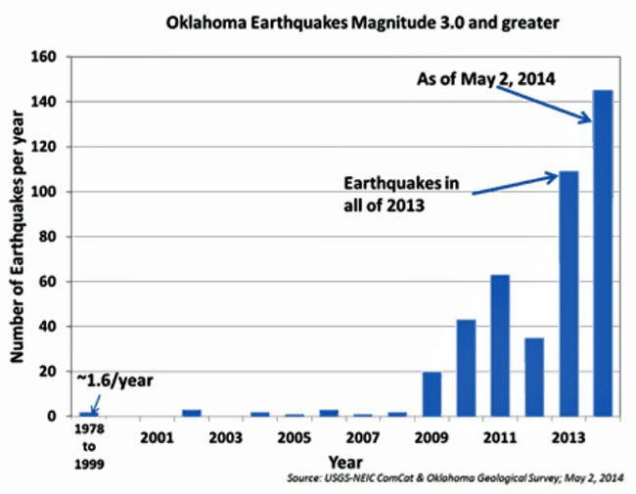
Bucket-Sort and Radix-Sort
Presentation for use with the textbook, Algorithm Design and Applications, by M. T. Goodrich and R. Tamassia, Wiley, 2015
USGS NEIC. Public domain government image.

Slide 3
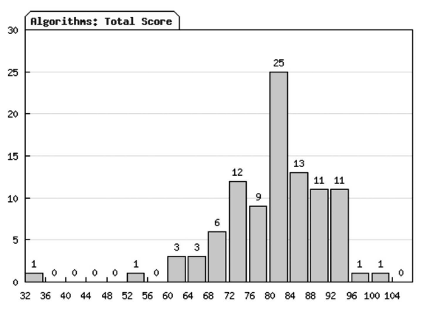
Application: Constructing Histograms
One common computation in data visualization and analysis is computing a histogram.
For example, n students might be assigned integer scores in some range, such as 0 to 100, and are then placed into ranges or “buckets” based on these scores.
A histogram of scores from a recent Algorithms course taught by one of the authors (with extra credit included).

Slide 4
Application: An Algorithm for Constructing Histograms
When we think about the algorithmic issues in constructing a histogram of n scores, it is easy to see that this is a type of sorting problem.
But it is not the most general kind of sorting problem, since the keys being used to sort are simply integers in a given range.
So a natural question to ask is whether we can sort these values faster than with a general comparison-based sorting algorithm.
The answer is “yes.” In fact, we can sort them in O(n) time.
A histogram of scores from a recent Algorithms course taught by one of the authors (with extra credit included).

Slide 5
Bucket-Sort
Let be S be a sequence of n (key, element) items with keys in the range [0, N − 1]
Bucket-sort uses the keys as indices into an auxiliary array B of sequences (buckets)
Phase 1: Empty sequence S by moving each entry (k, o) into its bucket B[k]
Phase 2: For i = 0, …, N − 1, move the entries of bucket B[i] to the end of sequence S
Analysis:
Phase 1 takes O(n) time
Phase 2 takes O(n + N) time
Bucket-sort takes O(n + N) time
^{Algorithm bucketSort(S):}
Input: Sequence S of entries with integer keys in the range [0, N − 1] Output: Sequence S sorted in nondecreasing order of the keys
let B be an array of N sequences, each of which is initially empty
^{for each entry e in S do}
^{k = the key of e}
^{remove e from S}
insert e at the end of bucket B[k]
^{for i = 0 to N−1 do}
^{for each entry e in B[i] do}
^{remove e from B[i]}
^{insert e at the end of S}

Slide 6
Example
Key range [0, 9]
7, d
1, c
3, a
7, g
3, b
7, e
Phase 1
1, c
3, a
3, b
7, d
7, g
7, e
B
0
1
2
3
4
5
6
7
8
9
∅
∅
∅
∅
∅
∅
∅
Phase 2
1, c
3, a
3, b
7, d
7, g
7, e

Slide 7
Properties and Extensions
Key-type Property
The keys are used as indices into an array and cannot be arbitrary objects
No external comparator
Stable Sort Property
The relative order of any two items with the same key is preserved after the execution of the algorithm
Extensions
Integer keys in the range [a, b]
Put entry (k, o) into bucket B[k − a]
String keys from a set D of possible strings, where D has constant size (e.g., names of the 50 U.S. states)
Sort D and compute the rank r(k) of each string k of D in the sorted sequence
Put entry (k, o) into bucket B[r(k)]

Slide 8
Lexicographic Order
A d-tuple is a sequence of d keys (k₁, k₂, …, k_{d}), where key k_{i} is said to be the i-th dimension of the tuple
Example:
The Cartesian coordinates of a point in space are a 3-tuple
The lexicographic order of two d-tuples is recursively defined as follows
(x₁, x₂, …, x_{d}) < (y₁, y₂, …, y_{d}) ⇔ x₁ < y₁ ∨ x₁ = y₁ ∧ (x₂, …, x_{d}) < (y₂, …, y_{d})
I.e., the tuples are compared by the first dimension, then by the second dimension, etc.

Slide 9
Lexicographic-Sort
Let C_{i} be the comparator that compares two tuples by their i-th dimension
Let stableSort(S, C) be a stable sorting algorithm that uses comparator C
Lexicographic-sort sorts a sequence of d-tuples in lexicographic order by executing d times algorithm stableSort, one per dimension
Lexicographic-sort runs in O(dT(n)) time, where T(n) is the running time of stableSort
Algorithm lexicographicSort(S)
Input sequence S of d-tuples Output sequence S sorted in lexicographic order
for i ← d downto 1
stableSort(S, C_{i})
Example:
(7,4,6) (5,1,5) (2,4,6) (2, 1, 4) (3, 2, 4)
(2, 1, 4) (3, 2, 4) (5,1,5) (7,4,6) (2,4,6)
(2, 1, 4) (5,1,5) (3, 2, 4) (7,4,6) (2,4,6)
(2, 1, 4) (2,4,6) (3, 2, 4) (5,1,5) (7,4,6)

Slide 10
Radix-Sort
Radix-sort is a specialization of lexicographic-sort that uses bucket-sort as the stable sorting algorithm in each dimension.
Radix-sort is applicable to tuples where the keys in each dimension i are integers in the range [0, N − 1]
Radix-sort runs in time O(d( n + N))
If d is constant and N is O(n), then this is O(n).
Algorithm radixSort(S, N)
Input sequence S of d-tuples such
that (0, …, 0) ≤ (x₁, …, x_{d}) and (x₁, …, x_{d}) ≤ (N − 1, …, N − 1) for each tuple (x₁, …, x_{d}) in S Output sequence S sorted in lexicographic order
for i ← d downto 1
bucketSort(S, N)

Slide 11
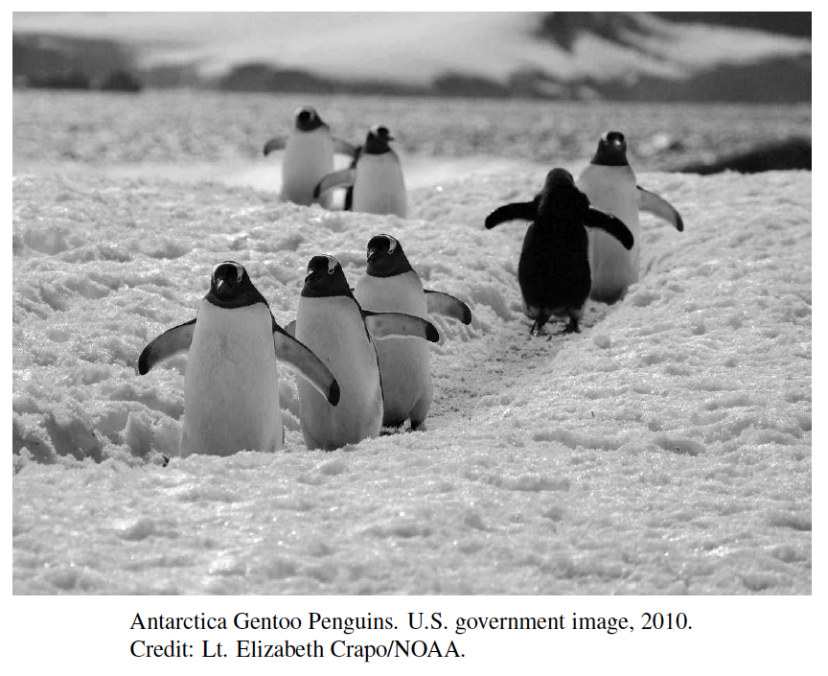
Selection
Presentation for use with the textbook, Algorithm Design and Applications, by M. T. Goodrich and R. Tamassia, Wiley, 2015

Slide 12
Application: Finding Medians
A common data analysis tool is to compute a median, that is, a value taken from among n values such that there are at most n/2 values larger than this one and at most n/2 elements smaller.
Of course, such a number can be found easily if we were to sort the scores, but it would be ideal if we could find medians in O(n) time without having to perform a sorting operation.
Median
< 50% below
< 50% above

Slide 13
The Selection Problem
Given an integer k and n elements x₁, x₂, …, x_{n}, taken from a total order, find the k-th smallest element in this set.
Of course, we can sort the set in O(n log n) time and then index the k-th element.
We want to solve the selection problem faster.
k=3
7 4 9 6 2 → 2 4 6 7 9

Slide 14
Quick-Select
Quick-select is a randomized selection algorithm based on the prune-and-search paradigm:
Prune: pick a random element x (called pivot) and partition S into
L: elements less than x
E: elements equal x
G: elements greater than x
Search: depending on k, either answer is in E, or we need to recur in either L or G
x
x
L
G
E
k < |L|
k > |L|+|E|
k’ = k - |L| - |E|
|L| < k < |L|+|E|
(done)

Slide 15
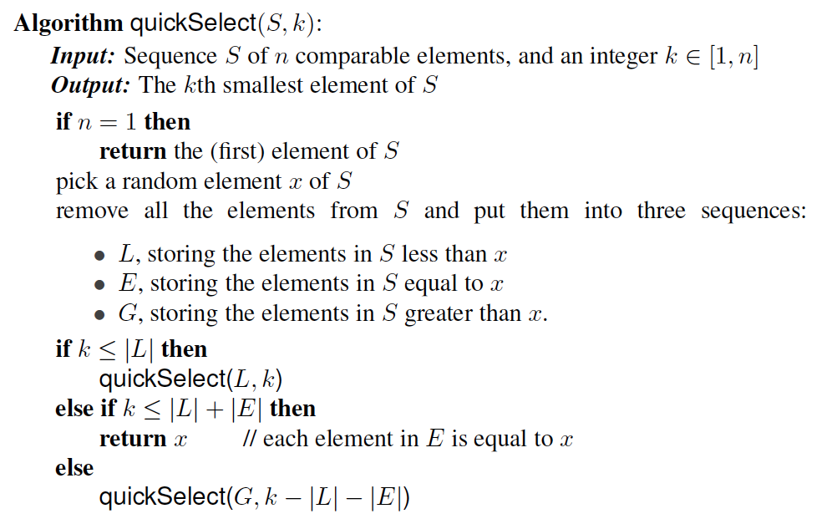
Pseudo-code
Note that each call to quickSelect takes O(n) time, not counting the recursive calls.

Slide 16
Quick-Select Visualization
An execution of quick-select can be visualized by a recursion path
Each node represents a recursive call of quick-select, and stores k and the remaining sequence
k=5, S=(7 4 9 3 2 6 5 1 8)
k=2, S=(7 4 9 6 5 8)
k=2, S=(7 4 6 5)
k=1, S=(7 6 5)
5

Slide 17
Expected Running Time
Consider a recursive call of quick-select on a sequence of size s
Good call: the sizes of L and G are each less than 3s/4
Bad call: one of L and G has size greater than 3s/4
A call is good with probability 1/2
1/2 of the possible pivots cause good calls:
7 2 9 4 3 7 6 1 9
7 2 9 4 3 7 6 1
2 4 3 1
7 9 7 1 → 1
1
7 2 9 4 3 7 6
Good call
Bad call
1 2 3 4 5 6 7 8 9 10 11 12 13 14 15 16
Bad pivots
Good pivots
Bad pivots

Slide 18
Expected Running Time, Part 2
Probabilistic Fact #1: The expected number of coin tosses required in order to get one head is two
Probabilistic Fact #2: Expectation is a linear function:
E(X + Y ) = E(X ) + E(Y )
E(cX ) = cE(X )
Let T(n) denote the expected running time of quick-select, let T(1)=b
By Fact #2,
T(n) < T(3n/4) + bn*(expected # of calls before a good call),
By Fact #1,
T(n) < T(3n/4) + 2bn
That is, T(n) is a geometric series:
T(n) < 2bn + 2b(3/4)n + 2b(3/4)²n + 2b(3/4)³n + …
So T(n) is O(n).
We can solve the selection problem in O(n) expected time.

Slide 19
About Stevens
A premier, private research university with a mission to inspire, nurture and educate leaders in tomorrow’s technology-centric environment while contributing to the solution of the most challenging problems of our time

